Slide 1
Demand Forecasting in Delivery
SIGMaTHON-1.0
Case company: SWIGGY
Team: Mythical techies.

Slide 2
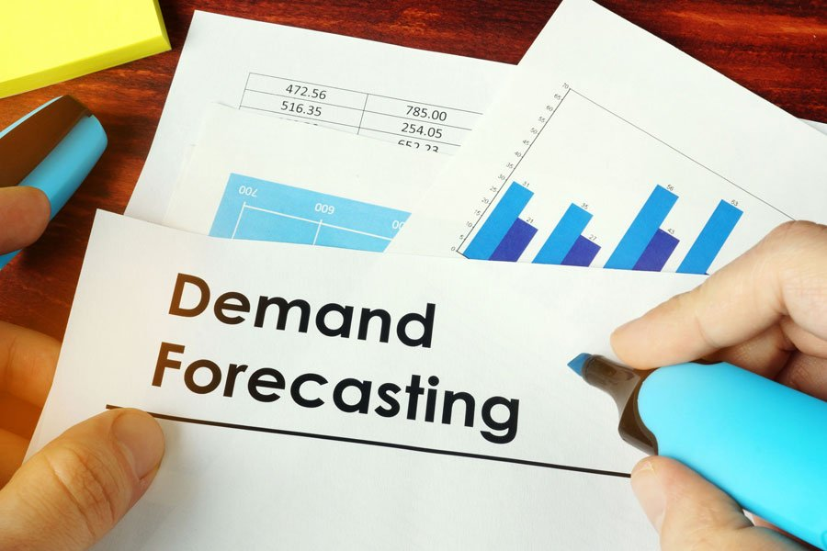
1. INTRODUCTION
This chapter aims to provide an entire background of the themes, company and purpose of the new process development.
Presentation of the case company-SWIGGY is given as well as the key concepts to resolve the existing problems.

Slide 3
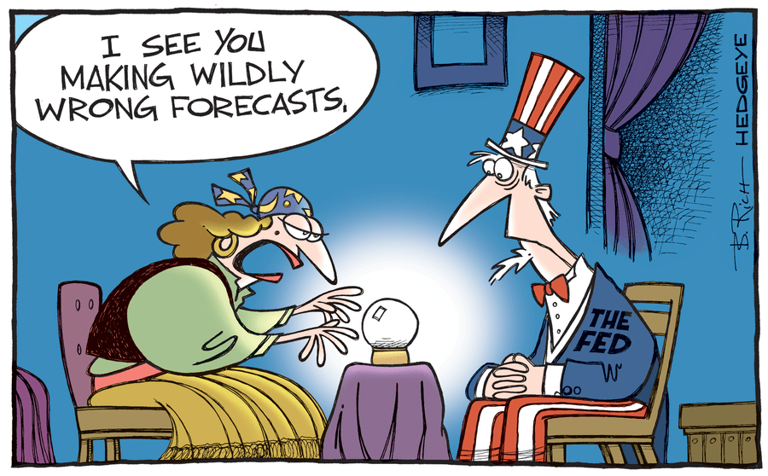
What is forecasting?
Process of predicting the future event
Underlying basis of all business decisions
Production
Inventory
Personnel
Facilities

Slide 4
Strategic Importance of Forecasting
Human Resources – Hiring, Training and Laying off workers.
Capacity – Capacity shortages can result in undependable delivery, loss of customers, loss of market shares.
Supply Chain Management – good supplier relations and price advantages.

Slide 5
Forecasting Factors
Time required in future
Availability of historical data
Relevance of historical data into future
Demand and sales variability patterns
Required forecasting accuracy and likely errors
Planning horizon / lead time for operational moves

Slide 6
What is Demand Forecasting?
Demand Forecasting is predicting the future demand for product/services of an organization.
To forecast is to calculate or estimate in advance
Since forecasts are estimates and involves consideration of so many prices and non-price factors, no estimate is necessarily 100% accurate.

Slide 7
Why Demand Forecasting?
To help decide on facility capacity planning and capital budgeting.
To help evaluate market opportunities worthy of future investments
To help assess it’s market share amongst other competitors
To serve as input to aggregate production planning and material requirement planning
To plan for other organizational inputs( like manpower, funds and financing) and setting policies and procedures.

Slide 8
Role of Demand Forecasting
Effective transportation system or supply chain design is predicted on the availability of accurate inputs to the modeling process.
One of the most important inputs are the demands placed on the system.
Forecasting techniques are used to predict, in the face of uncertainty, what the demands on the system will be in future so that the appropriate designs and operating plans can be devised.

Slide 9
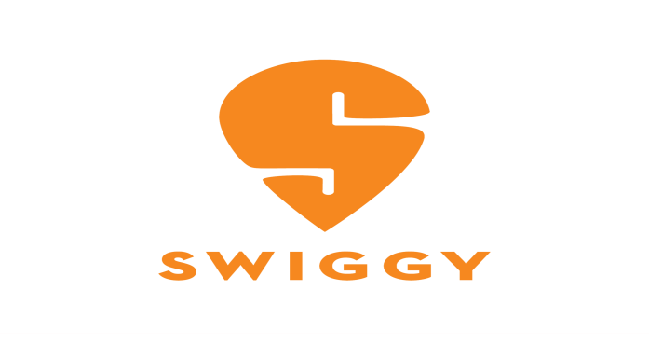

SWIGGY’s story
It all started back in 2014, when two BITS Pilani graduates, Sriharsha Majety and Nandan Reddy decided they wanted to make life easier by changing the way India eats - all with just a tap! With their idea of 'hyperlocal food delivery'.
Later they met Rahul Jaimini, who brought this vision to life with the first website. And with this, Swiggy was launched as a food ordering & delivery platform.
A single window for ordering from a wide range of restaurants. Exclusive fleet of delivery personnel to pickup orders from restaurants and deliver it to customers

Slide 10
Company business model
GROWTH
SELECTION
CUSTOMER
EXPERIENCE
TRAFFIC
RESTAURANT
KEY BUSINESS UNITS
* Operations
* Marketing
* Fleet management team
* Customer care team
* Analytics and Market research team

Slide 11
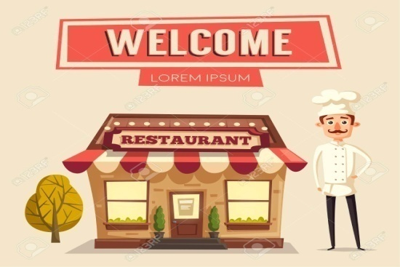
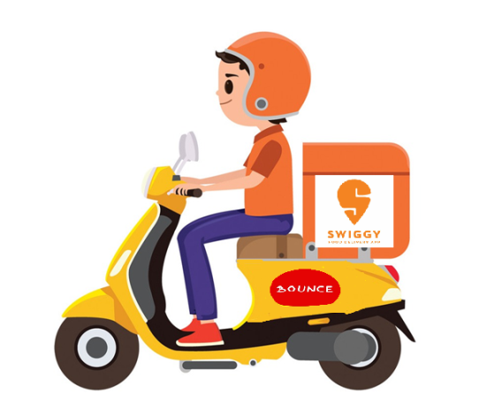
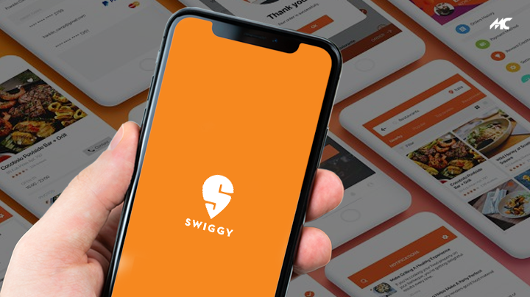
Content
Flocking population to metro cities
IT professionals
Easy food, efficient time goals
Need of the hour for many
Busy life, socioeconomic factors
Market relevance

Slide 12
SWOT analysis
strengths
Quick delivery
opportunities
Pioneer in food delivery business
Lack of market leader
threats
Unstable and low customer base
Laws and government regulations
Good brand image
Trained delivery personnel’s
Responsive customer support
Growing market
Increasing market share
Minimal competition
Increasing potential competitions
Increasing health consciousness

Slide 13
SWIGGY’S Financial
Swiggy Capital Structure( 2017-2018)
Swiggy Income Statement
Swiggy total Funding | $465.5m
Swiggy latest funding size | $210m
Swiggy’s latest valuation | $1.3b(2018-6-21)
Millions of INR | FY,2016 | FY,2017
Revenue | 1.16 bn | 235.90bn
Revenue growth, % |  | 20254%
Net income | -0.21bn | -1,371.80bn

Slide 14
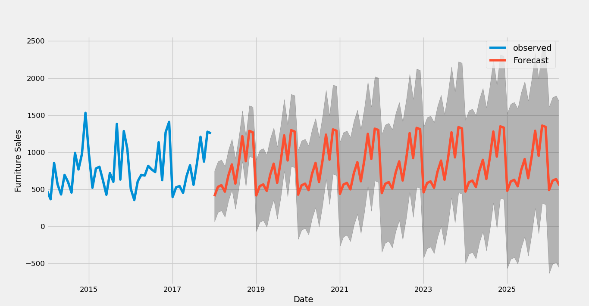
Customer Prediction
observed vs forecast

Slide 15
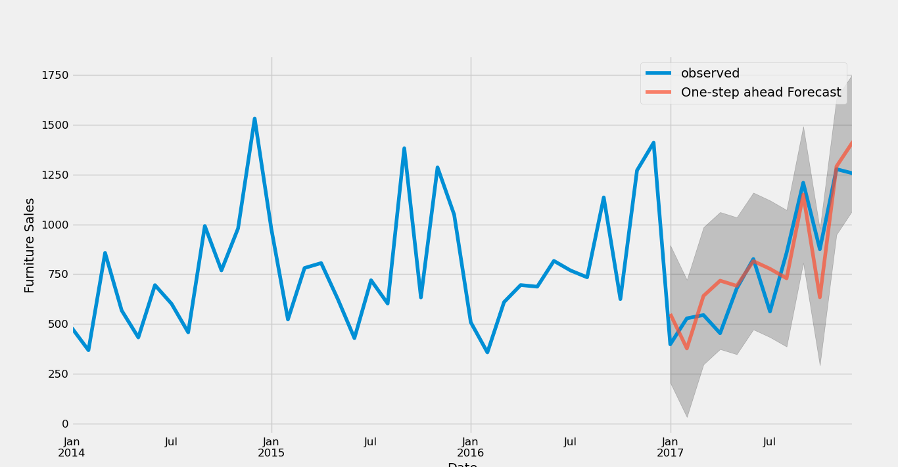
observed vs one-step ahead forecast

Slide 16
Thankyou for your attention

